Slide 1
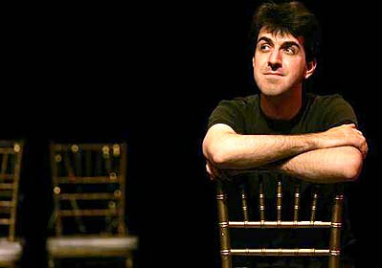
Jason Robert Brown
By: Jennifer Chapman

Slide 2
What So Different?
Jason Robert Brown has been compared to Steven Sondheim by multiple newspapers and theatre gurus. His music is smart, sophisticated, and memorable. He plays with meter, tempo, and unmodified formatting. Chorally speaking, his music tends to be complex and unconventional. He writes for a full orchestra and ensemble but prizes his solo singers with beautiful pieces.

Slide 3
The Beginning
Born on June 20, 1970
Born in Ossining, New York
Raised Jewish
Interested in music from a very young age.

Slide 4
Education
Eastman School of Music
French Woods Festival of the Performing Arts
Left school to continue music

Slide 5
Work
Started as an arranger, conductor, and pianist.
Opened “Songs for a New World” for his first major production
Scored the musical “Parade,” and won a Tony Award for Best Original Musical Score in 1999
Opened “The Last Five Years” as a musical and wrote a coinciding book as well.
Collaborated with many composers for different musical theatre scores.

Slide 6
Work (Continued)
Released Solo Album “Wearing Someone Else’s Clothes.”
Completed the score for the musical “13.”
Teaches Musical Theatre Performance and composition at the University of Southern California.
Travels regularly to do theatrical workshops
Working on a new project “Honeymoon in Vegas.”

Slide 7
Who He Knows
His career really took off once he met Daisy Prince. As they collaborated, they realized they worked incredibly well together. Daisy then introduced JRB to her father Hal Prince, who directed “Parade” and offered Brown the opportunity to write the score.
Since his beginning, he has worked with Liza Minnelli, John Pizzarelli, Laurie Beechman, Kelli O’hara, began the group “The Tonics,” and has worked with Charles Strouse and Lee Adams on composing the musical “Star Wars.”

Slide 8
“The Last Five Years” And How It Plays Into JRB’s Life
“The Last Five Years” has come to be one of the most well known pieces of Brown’s work. The story is based on his experience with the marriage and divorce of his first wife, Theresa. After production, Brown had to completely rename the female character and change some points in the plot because Theresa threatened to take legal action claiming the plot represented their relationship to closely.

Slide 9
Trying To Find A Score…
Since “The Last Five Years” was changed, it has been difficult to find a full Jason Robert Brown score. Even the shows which have rights are altered. The only original soundtrack/score that exists is the actual original performed on the stage. Brown always changes his scores slightly after a show closes so that it is never the true complete score. I believe the dilemma with his past wife made it so he feels like that is the only way to keep the things he wants in his control. I fully understand why he would do this, but this is just opinion.

Slide 10
The Up And Coming
The most exciting information for JRB’s upcoming plans (in my opinion) is “The Last Five Years” being produced into a film. The story will have to change some to be suitable for a movie, but I’m excited to see his collaboration with the director and producers. (Jason Robert Brown is pretty picky with what he likes!)
He is also working on a new musical based on the film “Honeymoon in Vegas.” No dates of opening have yet been released.

