Slide 1
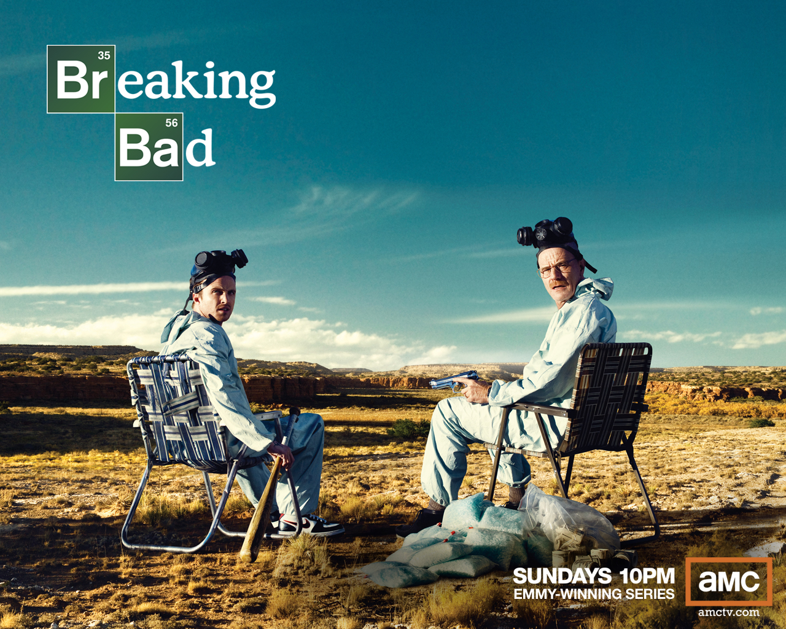
… The facts about its TV
Pop Culture

Slide 2
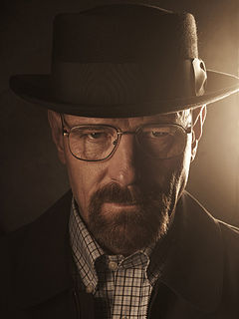
“[He] can pull off anything… He does so many horrible things and the fans are still like:
-Aaron Paul
Rolling Stone, Issue 1163
‘YEAH, WALT! POISON THAT KID!’ ”

Slide 3
“ “Breaking Bad” follows protagonist
Walter White (Bryan Cranston),
a chemistry teacher who lives in
New Mexico with his wife and teenage son
…
White is diagnosed with Stage III cancer
and given a prognosis of
two years left to live…

Slide 4
With … a desire to secure his family's
financial security, White chooses to enter a
dangerous world of drugs and crime
[with his former student, Jesse Pinkman]
…
[This] series explores how a fatal diagnosis
… releases a typical man from the
daily concerns and constraints of normal
society and follows his transformation
from a mild family man to
a kingpin of the drug trade.”
-www.amc.com/breakingbad

Slide 5
The truth is…
A person can never really see every
aspect of another’s life.
Even if it were possible, any presence
would hinder true reactions.
How many people are truly open to
showing themselves in times weakness
to someone constantly?
This is a reason why
media can be so intriguing.

Slide 6
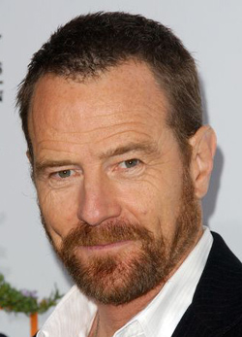
“There’s this assumption that the lead character
in a show needs to be
likable or sympathetic.
People ask,
“How am I supposed
to still like you?”
I answer: “Are you
supposed to
still like me?”
-Bryan Cranston

Slide 7
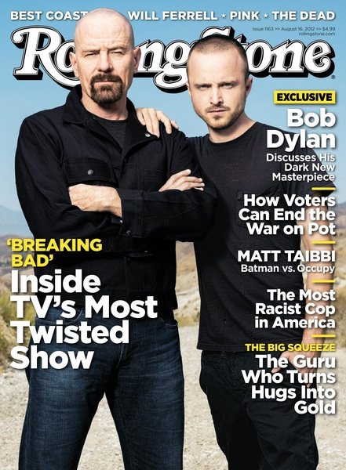
“At times the show seems to
glamorize
the idea but as soon
as you think it
would kind of be cool…
they bring you
back to reality,
show the real dangers…
you will then, hopefully,
take a step back.”
-Director, Vince Gilligan

Slide 8
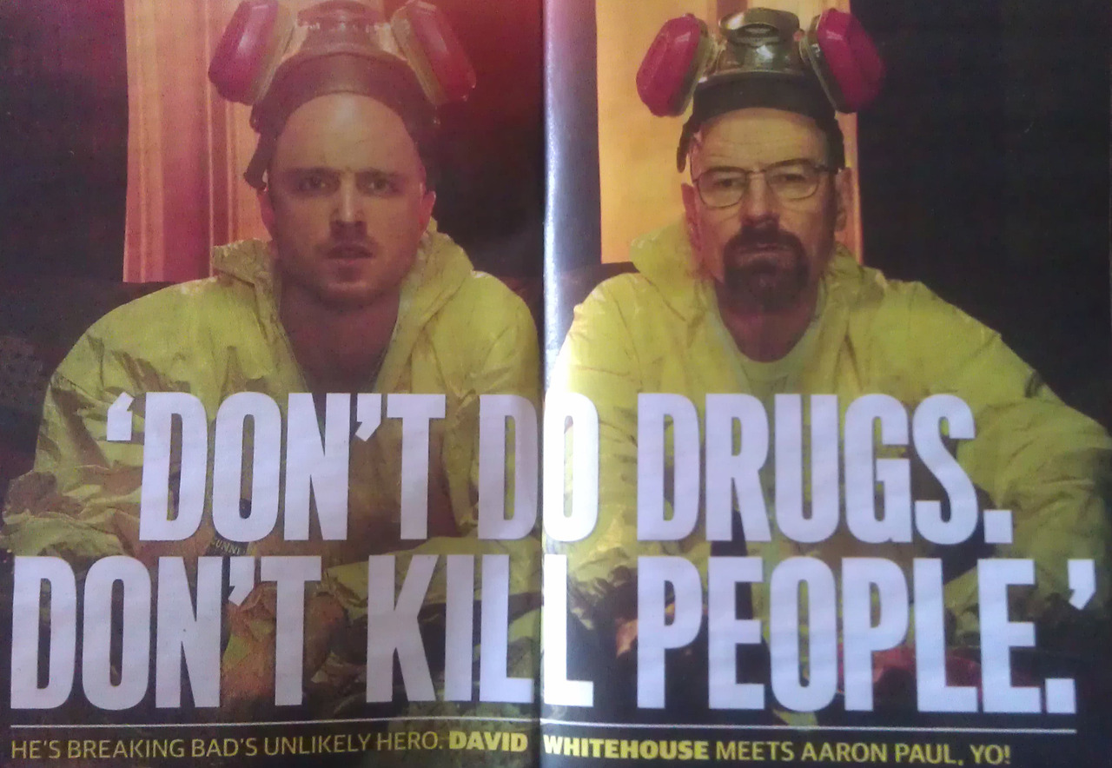

Slide 9
“Now you’re playing this role that
has just gone rogue evil…”
“When we started he was a
really sweet man. He was a family guy.
He had a bad hand dealt to him & he thought:
“well, I’m going to die in
two years, I’m going to go out on my terms.”
So he chooses to take his chemistry background, become a drug dealer, make money for his family, and then die.
Simple plan… Right?”
-Bryan Cranston

Slide 10
“It's crazy [that people side with Jesse].
At the beginning, everyone,
including me,
saw him as just a drug burn-out…
But as each episode was revealed…
it showed quite the opposite.
It's incredible how Walt and Jesse are
completely trading positions.
Walt has no morals whatsoever any
more, and Jesse, who wants to try
to be good, is terrified of him.”
- Aaron Paul

Slide 11
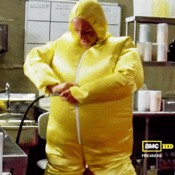
SO…
I apparently really like
“Breaking Bad.”
But what are the actual statistics
of Americans mirroring my feelings?

Slide 12
According to
Leichtman Research
In July of 2012:
87%
of US households
subscribed to some form of
multi-channel video service.

Slide 13
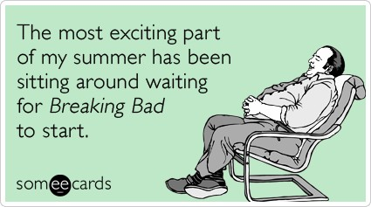
“Breaking Bad” averages 1.9 Million
Viewers Per season
The Season Four finale had
2.9 Million viewers

Slide 14
Season Four increased
viewers over
one season by:
And among adults
(aged 18-34), audience
grew over
24%
(ages 18-49)
The largesT growth record
for a drama on basic cable.
42%
Over season
three alone

Slide 15
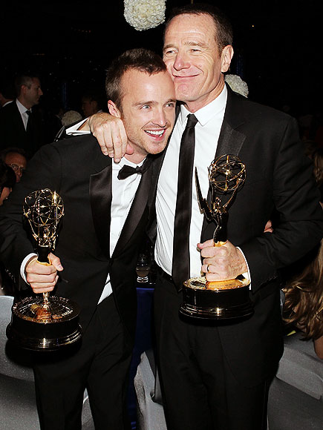
Over four seasons
Breaking Bad has had:
23 Emmy nominations
Winning seven
(Including):
Bryan Cranston
Best Lead Actor in A Drama
Series (3 consecutive years)
Aaron Paul
Best Supporting Actor
In A Drama Series
(2 consecutives years)

Slide 16
“Breaking Bad” currently has
And according to Socialbaker,
“Breaking Bad” gains
147,340
“Likes” or “Followers” a month.
3,667,203
“Likes” on Facebook
180,243 “Followers” on Twitter

Slide 17
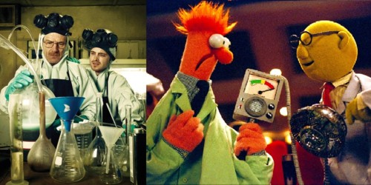
The numbers show Success
But what are people saying?

Slide 18
“We have elements of an
average American family
injected into a world so abstract to their
own reality that it becomes a further study in our
principle character…”
-Mark Geller
“[It] is such a respected and popular show, because it
develops characters
in an amazing way. People fully
understand and care
about Walter [and] Jesse, … They are so relateable…”
- Andy Searles

Slide 19
“It's funny,
I don't have young girls running up to
me screaming and crying,
I have grown men running up to me
screaming and crying. I love it, though.”
-Aaron Paul

Slide 20
TWITTER
“It would be nice if it was possible to miss a human being as much as Breaking Bad.”
“There's no way smoking meth is as addictive or stressful as watching Breaking Bad.”
“Sitting in biology. Hear familiar terms. How do I know this? Realization. ‪ Thanks ‪#BB for helping with education.”
“If someone asks if you watch Breaking Bad, it means they want to converse with you, so if you don't watch it you're letting them down.”
“HOLY ‪#BREAKINGBAD!! My heart is racing faster than a racehorse who has to pee but cant pee on the track because its potty trained!”

Slide 21
It wasn’t my typical television indulgence,
developing a story based on
drugs, power, money, violence, & deception.
But the thing I developed the most was
love for the characters.
I witnessed each character’s
struggle and development,
felt every emotional experience deeply.
They became real to me. And for the first time,
I didn’t feel so alone.

Slide 22
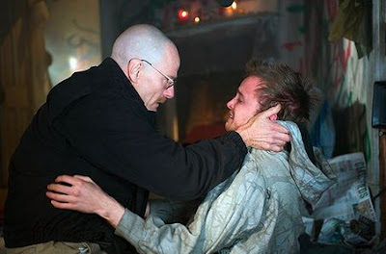
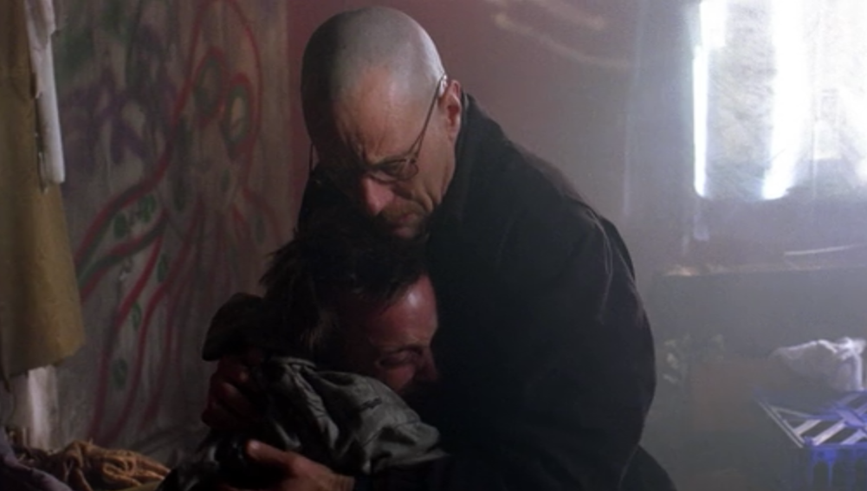
“We’re taught from a
very early age by society, by our parents,
by teachers
to edit things we
think,
feel,
& do.
We live a life
of editing.
…

Slide 23
… Theologically, I think [Breaking Bad] puts up a mirror to
society that, given the right set of circumstances,
I think anyone & everyone
has a little darkness inside them
;
Given the right set of circumstances, that little person in
you can come alive, thrive & live within you.”
-Bryan Cranston

Slide 24
I am in no means a drug lord named HeisenburG,
I’ve never lost everything, I’m not a wife whose husband has cancer, a police officer, or an owner of a fast food chain that sells chicken sandwiches.
I am a human being with very real feelings.
Through “Breaking Bad” I can witness the struggle of someone else’s life and realize that
I’m not alone
in feeling the
overwhelming power and deception
of the human mind & heart.

Slide 25
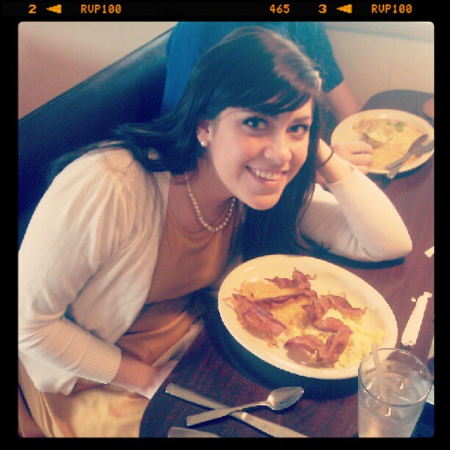
By: Jen Chapman
Photo inspired by Walter White

Slide 26
Sources:
Hiatt, Brian. "Chemical Brothers." Rolling Stone. Issue 1163, Aug. 16 2012: 46-52. Print.
Geller, Mark, and Andy Searles. "Why do people like Breaking Bad so much? ." Oct 14 2012. , Online Posting to Quora. Web.
Whitehouse, David. "Breaking Bad: Aaron Paul plays a drug-dealing killer and viewers can't get enough of him." The Guardian. Nov, 12 2012. Web
Segal, David. "The Dark Art of ‘Breaking Bad’." New York Times 06 Jul 2011, Magazine. Web.
Skye, Dan. "The HIGH TIMES Interview: Bryan Cranston." High Times. Aug. 16 2012. Magazine. Web.
Harris, Will. "Bryan Cranston on Breaking Bad's craziest season and what's next." Onion, AV Club. 07 2012: Web.
Giroux, Jack. "Bryan Cranston Talks Walter White’s Journey and Breaking Bad’s Mirror to Society." Film School Rejects. Sept, 01 2011: Web.
http://www.amctv.com/shows/breaking-bad
http://www.rehabinfo.net/breaking-badass/
Factbrowser.com: Search: Breaking Bad
http://www.uproxx.com/webculture/2012/07/jesse-pinkman-gifs

